Slide 1
Acceptance Test
Wednesday, May 1, 2013

Slide 2
Agenda
What’s Next?
Unit Tests
Integration Test
Introduction
Project Progression
Restatement of Problem
User Case Narratives
Acceptance Test
Live Demo

Slide 3
Welcome
Our Client:
Dr. Darren Lim
Professor of Computer Science
Siena College

Slide 4
Introduction
Alyssa Nghiem
Team Leader / Web Master
Eduardo Pinto Barbosa
Team Leader / QA Lead
Ryan Kennedy
Lead Programmer
Christopher Small
Assistant Programmer
Tyler Vorpahl
Web Designer

Slide 5
Agenda
What’s Next?
Unit Tests
Integration Test
Project Progression
User Case Narratives
Acceptance Test
Live Demo
Introduction
Restatement of Problem

Slide 6
Problem
The CCSCNE conference is complex and difficult to manage
CCSCNE - Consortium for Computing Sciences in Colleges North East

Slide 7
WORMS
Web Organization Registration Management System
Integrated System that handles…
Attendee Registration
Scholarly Works Submission
Scholarly Works Review
Information Access

Slide 8
Agenda
What’s Next?
Unit Tests
Integration Test
Introduction
Restatement of Problem
User Case Narratives
Acceptance Test
Live Demo
Project Progression

Slide 9
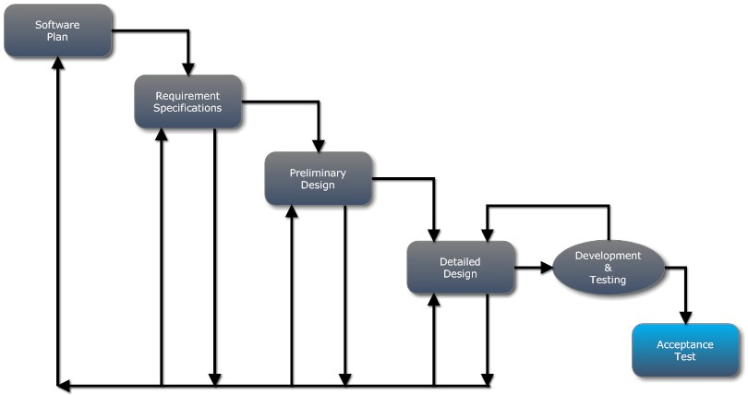
Project Progression

Slide 10
Agenda
What’s Next?
Unit Tests
Integration Test
Introduction
Restatement of Problem
Acceptance Test
Live Demo
User Case Narratives
Project Progression

Slide 11
Use Case Narratives
Describes the capabilities of each user

Slide 12
Conference Attendee
Able to register for the conference
Able to make meal selections
Able to view a schedule of events for the conference

Slide 13
Submitter
Uploads a scholarly work
Specifies topics for the work
Specifies a title for the work
Able to check whether a submission has been reviewed
Able to view a list of submitted works

Slide 14
Reviewer
Submits credentials for approval
Views a list of works assigned for review
Downloads a PDF of each assigned work
Submits a review for each assigned work

Slide 15
Submission Chair
Able to accept or reject submitted scholarly works
Able to view a list of the submitted scholarly works and their authors
Able to approve or deny reviewer applications

Slide 16
Conference Chair
Able to configure conference information
Schedule time and location of events for the conference
Able to configure banquet meal selections
Able to configure the topics that submissions can be categorized into

Slide 17
System Admin
Specifies email addresses of Conference Chairs and Submission Chairs
Configures the type of submission each Submission Chair is responsible for

Slide 18
Programming Contest Team Advisor
Able to create a programming contest team
Able to specify the members of the team

Slide 19
Programming Contest Participant
Able to see that an advisor has assigned him/her to a team
Able to view contest details

Slide 20
Agenda
What’s Next?
Integration Test
Introduction
Restatement of Problem
Acceptance Test
Live Demo
Unit Tests
Project Progression
User Case Narratives

Slide 21
Unit Testing
Unit Tests
Determine whether or not each major component of the software functions properly
Made up of Test Cases
Test Case – an individual test
Actions to perform
Expected results

Slide 22
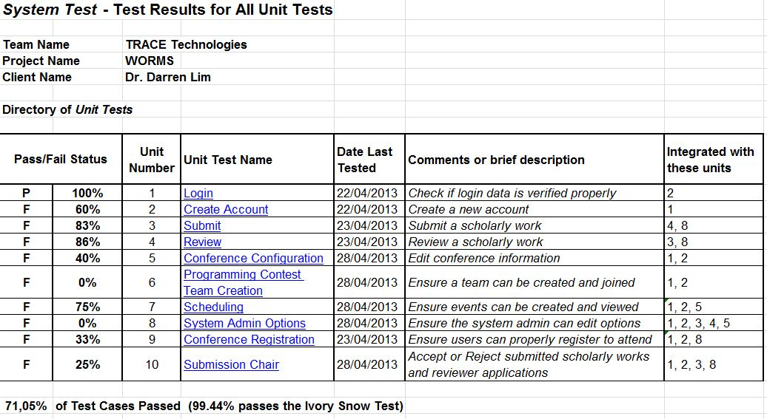
Unit Test Directory

Slide 23
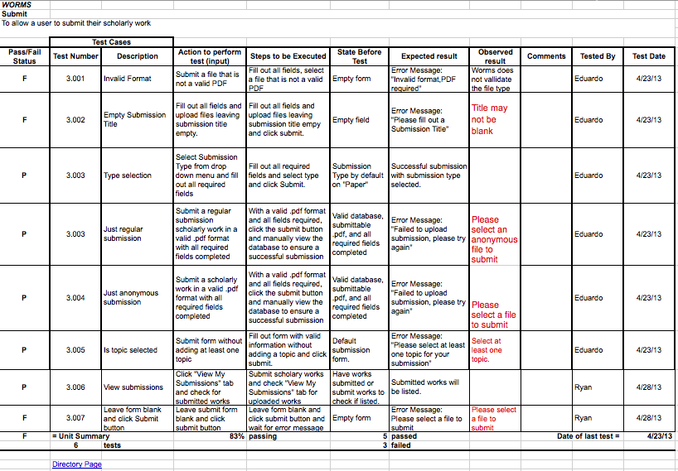
Unit Test Example

Slide 24
Agenda
What’s Next?
Introduction
Restatement of Problem
Acceptance Test
Live Demo
Integration Test
Project Progression
User Case Narratives
Unit Tests

Slide 25
Integration Test
Integration tests were used to check whether system components worked together properly
A system test is an integration test of all components
Determines whether the functional requirements are met

Slide 26
Agenda
What’s Next?
Introduction
Restatement of Problem
Live Demo
Acceptance Test
Project Progression
User Case Narratives
Unit Tests
Integration Test

Slide 27
Acceptance Test
An Acceptance Test is a final test to determine whether or not all functional and nonfunctional requirements are met
Each requirement is marked with a yes and no

Slide 28
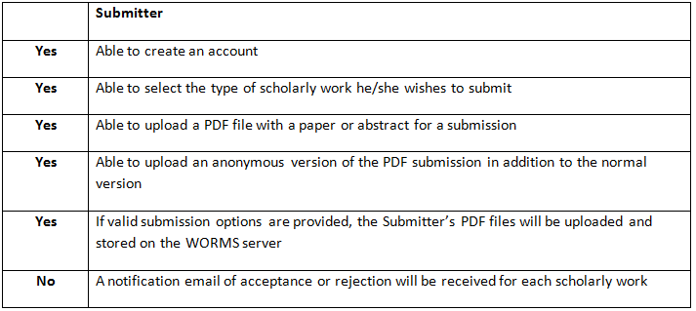
Acceptance Test

Slide 29
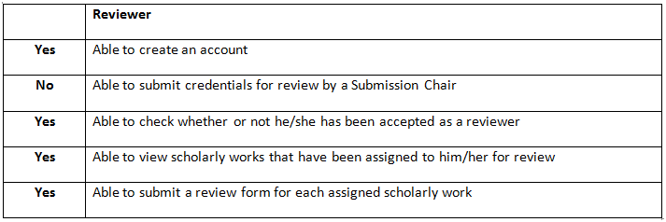
Acceptance Test

Slide 30
Acceptance Test

Slide 31
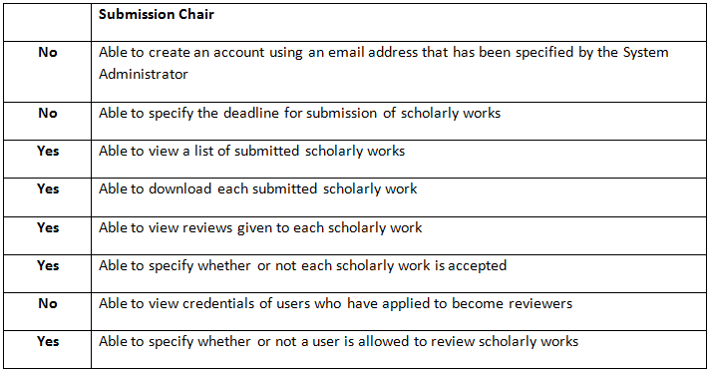
Acceptance Test

Slide 32
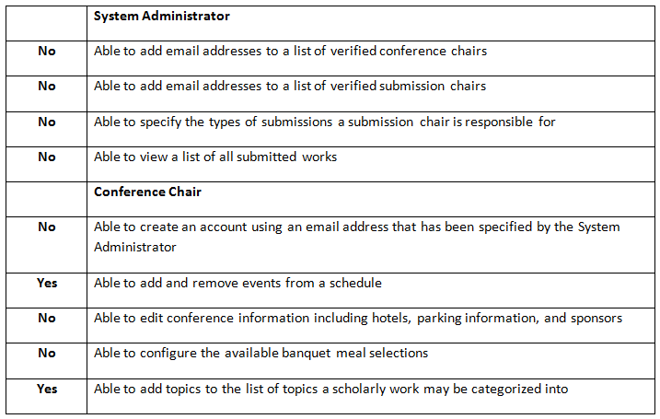
Acceptance Test

Slide 33
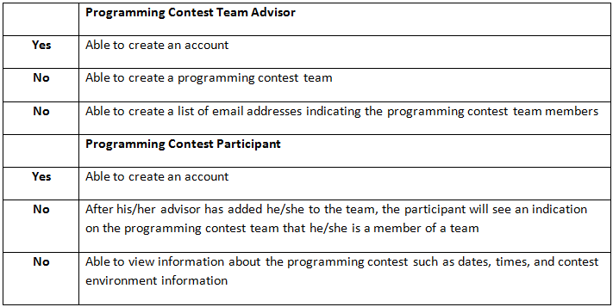
Acceptance Test

Slide 34
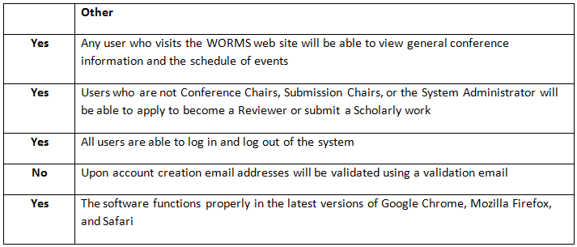
Acceptance Test

Slide 35
Agenda
What’s Next?
Introduction
Restatement of Problem
Live Demo
Project Progression
User Case Narratives
Unit Tests
Integration Test
Acceptance Test

Slide 36
Prototypes
Live Demo

Slide 37
Agenda
Introduction
Restatement of Problem
What’s Next?
Project Progression
User Case Narratives
Unit Tests
Integration Test
Acceptance Test
Live Demo

Slide 38
What’s Next
Siena College Academic Celebration – May 3
Software Engineering Party – May 6
CSIS End of the Year Party – May 18
Graduation Commencement – May 19

Slide 39
The End

